Slide 1

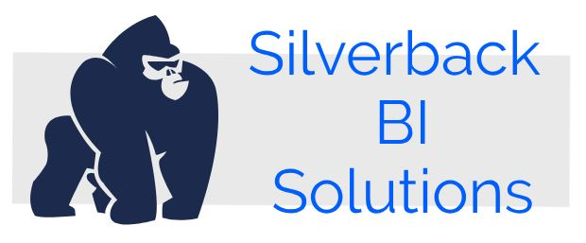
Maximum Miniatures Business Intelligence
By Silverbacks BI Solutions
April 26, 2019

Slide 2
Mike Morshedi
Steve Ennis
Matt Band
Ali Samavati
MEET THE TEAM

Slide 3
3
BI Project Overview
About Maximum Minaitures Inc.
Business Requirements
Manufacturing / Production Reports
Sales Reports
The Back-end Processes of the BI Project
Final words

Slide 4

Maximum Miniatures
BI Project
4
About Maximum Miniatures
300% Growth in Last Three Years
Growing Markets
Increased Competition
Aging Reporting Mechanisms

Slide 5
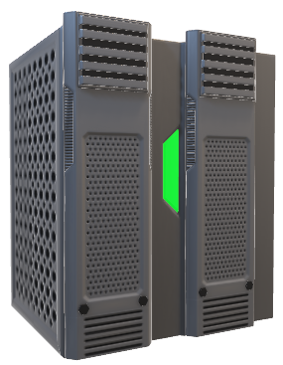
5
Current Sources
Business Intelligence
for Max Min, Inc.
Order Processing System
Microsoft SQL Server
Manufacturing Automation
Comma-Delimited Text File
Accounting System
Microsoft SQL Server
The challenge is to integrate these systems together to create a fully functional Business Intelligence system usable by those that need to make decisions
Faster and Smarter.

Slide 6
6
Manufacturing Requirements
Manufacturing
Time
Ability to drill down by:
Rejected
Products
Inventory
Manufacturing Process
Time (Year, Quarter, Month, Day)
Machine
Current
Backorders
Product Type
Accepted
Products
Rejection Percentage KPI
Manufacturing Material

Slide 7
7
Sales Requirements
Regional
Sales
# Sold
Products
Sales Tax
Charges
Ability to view by:
Sales Process
Time (Day, Month, Quarter, and Year)
Store
Product
Value
Shipping
Charges
Sales Promotion
Product
Customer
Salesperson

Slide 8

8
The Reports

Slide 9
9
Back-End Processes
This is the process we followed to provide suitable reports for this project
Reporting
Designing Architecture
BA for BI
Analysis Services
ETL
GO
Notes:
It demands a lot of effort to reach this point

Slide 10



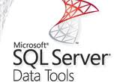
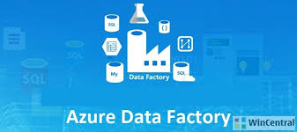
AVAILABLE SOLUTIONS FOR DEVELOPING BACK-END ON MICROSOFT PLATFORM

Slide 11




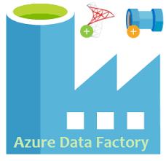


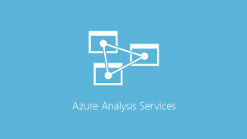

Available Options
11
Power BI
End to End
Implementation
Multidimensional
Tabular On-Premises
Tabular On Azure

Slide 12
12
What are the reasons behind our decision?
Different countries: Japan, USA, India and Germany
Lower cost compare to On premise
More reliable, flexible, and in-demand configuration
BI developers can work independently of the
location

Slide 13




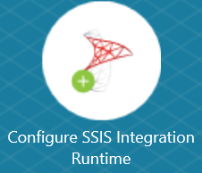
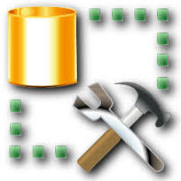

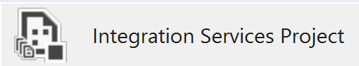

Solution Architecture
13
Azure Analysis Services
OrderProcessingSystem
MaxMinAccounting
MaxMinManufacturingDW
Storage Account
BatchInfo
Create
Schedule & Execute
DEPLOY
DEPLOY
SSISDB On Azure SQL
Schedule & Execute
Local System

Slide 14
Pricing Information
14
7.67 CAD to 24575.95 CAD
US$ 0.29/hour to US$ 92.6/hour

Slide 15




15
Delivery Methods
1
PERSONAL COMPUTER
Bring up reports while at the office, create your own dashboards!
2
LAPTOP
When you’re on the go you have the ability to connect to the cloud and review reports
3
TABLET
Download the PowerBI app and you can stay connected with the same great visuals you get at the office
4
MOBILE
On the run? Check in with mobile capability

Slide 16
16
Recommendations
Wholesale Cost should be added to Order Processing System to determine profit margin
Shipping Costs should be added to Order Processing system to track costs
Greater communication between Sales, Inventory and Manufacturing could lower storage costs and increase sales
Implement data capture processes that will provide the information to enable intelligent business decisions
You can always reduce your expenses on IT infrastructure by designing an optimized model and considering performance tuning

Slide 17

Silverbacks BI Solutions
THANKS
FOR LISTENING
We are open to any questions

